Slide 1
SYSTEM DEVELOPMENT LIFE CYCLE (SDLC)

Slide 2
SYSTEM DEVELOPMENT LIFE CYCLE (SDLC)
The systems development life cycle is a phased approach to solving business problems
Developed through the use of a specific cycle of analyst and user activities
Each phase has unique user activities.
Incorporating Human-Computer Interaction (HCI) Considerations
  The demand for analysts who are capable of incorporating HCI into the systems development process keeps increasing, as companies begin to realize that the quality of systems and the quality of work life can be improved by taking a human-centered approach at the outset of a project
Notes:
Analysts disagree on exactly how many phases there are in the SDLC.
Each phase consists of activities which overlap into other phases and then taper off, rather then done in separate steps.

Slide 3
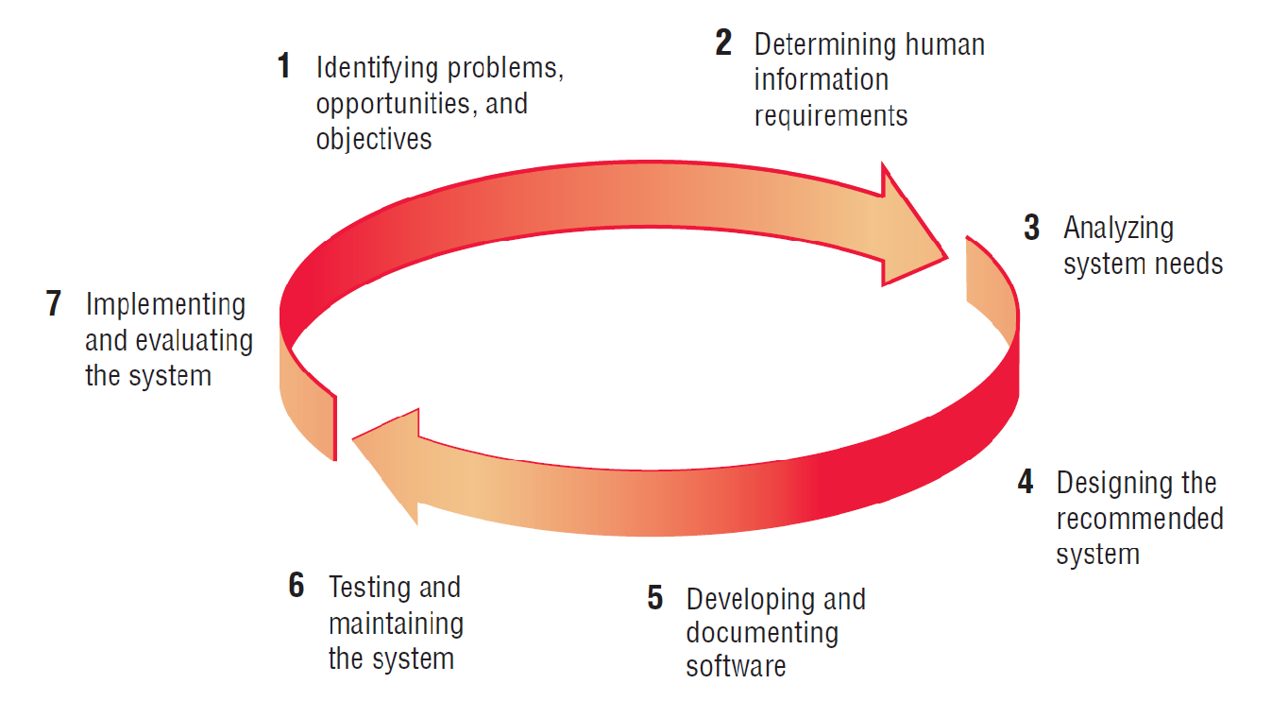
SDLC – THE SEVEN PHASES

Slide 4
PHASE 1: Identifying Problems, Opportunities & Objectives
ACTIVITY:
  Interviewing user management
  Summarizing the knowledge obtained
  Estimating the scope of the project
  Documenting the results
OUTPUT: FEASIBILITY REPORT
  containing problem definition and objective summaries from which management can make a decision on whether to proceed with the proposed project (come out with your system proposal)
Notes:
Critical to the success of the rest of the project, because no one wants to waste time addressing the wrong problem.
Problems – generally the reason the analyst was called in in the first place.
Opportunities – situations that the analyst believes can be improved through the use of computerized information systems.
Objectives – how can the business reach its objectives by addressing specific problems or opportunities.

Slide 5
PHASE 2: Determining Human Information Requirements
ACTIVITY:
  Interviewing
  Sampling and investing hard data
  Questionnaires
  Observe the decision maker’s behavior and environment
  Prototyping
  Learn the who, what, where, when, how, and why of the current system
OUTPUT:
  Analyst understands how users accomplish their work when interacting with a computer; and begin to know how to make the new system more useful and usable.
  The analyst should also know the BUSINESS FUNCTIONS and have complete information on the people, goals, data and procedure involved.
Notes:
Determining human needs of the users involved.
Uses activities to pose and answer questions concerning human-computer interaction:
What are the users strengths and limitations?
Trying to understand what information users need to perform their jobs.
Who – the people who are involved
What – the business activity
Where – the environment in which the work takes place
When – the timing
How – how the current procedures are performed
Why – why the system uses the current system

Slide 6
PHASE 3: Analyzing System Needs
ACTIVITY:
  Create data flow diagrams
  Complete the data dictionary
  Analyze the structured decisions made
  Prepare and present the system proposal
OUTPUT:
  Recommendation on what, if anything, should be done
Notes:
Data Flow Diagrams – chart the input, processes, and output of the business’s functions in a structured graphical form.
Data dictionary – lists all the data items used in the system, as well as their specifications.
Structured decisions made – those for which the conditions, condition alternatives, actions, and action rules can be determined.
Structure decision methods:
structures English
decision tables
decision trees
System proposal – summarizes what has been found
about users
usability and usefulness of current system
provides cost/benefit analysis of alternatives
makes recommendations on what (if anything) should be done
The recommendation or solution is based on the analysts individual qualities and professional training and their interaction with users.

Slide 7
PHASE 4: Designing the Recommended System
ACTIVITY:
  Design procedures for data entry
  Design the human-computer interface
  Design system controls
  Design files and/or database
  Design backup procedures
OUTPUT:
  Model of the actual system
Notes:
Uses the information collected earlier to accomplish the logical design of the information system:
designs procedures for users to help them accurately enter data
provides for users to complete effective input to the information system
devises the human-computer interface
designs files or databases that will store the data needed by decision makers
designs output (onscreen or printed)
designs controls and backup procedures

Slide 8
PHASE 5: Developing and Documenting Software
ACTIVITY:
  System analyst works with programmers to develop any original software
  Works with users to develop effective documentation
  Programmers design, code, and remove syntactical errors from computer programs
  Document software with help files, procedure manuals, and Web sites with Frequently Asked Questions
OUTPUT:
  Computer programs
  System documentation
Notes:
The analyst uses structure charts and pseudocode to communicate to the programmer what needs to be programmed.
Documentation includes:
procedure manuals
online help
Web sites
“Read Me” files
Because users are involved from the beginning, the documentation should address the questions they have raised and solved jointly with the analyst.

Slide 9
PHASE 6: Testing & Maintaining the System
ACTIVITY:
  Test the information system
  System maintenance
  Maintenance documentation
OUTPUT:
  Problems (if any)
  Updated programs
  Documentation
Notes:
Testing should take place first with sample data and then with actual data.
Testing is done by both the programmers and the analyst
The maintenance started here is carried out routinely through the life of the system.
updates may be performed via a vendor site on the Web.

Slide 10
PHASE 7: Implementing & Evaluating the System
ACTIVITY:
  Do user training
  Analyze the plan to make sure smooth conversion from old system to new system
  Review and evaluate system
OUTPUT:
  Trained personnel
  Installed system
Notes:
Training users to handle the system.
System conversion – converting files from old formats to new ones, or building a database, installing equipment, and bringing the new system into production.
Actually evaluation takes place during every phase.

